Slide 1
Comprehensive Economic Development Strategy (CEDS) Data for ECIRPD
Annie Cruz-Porter, PhD
Community and Regional Development Specialist
Purdue Center for Regional Development
August 2024

Slide 2
ECI demographics

Slide 3
Population

Slide 4
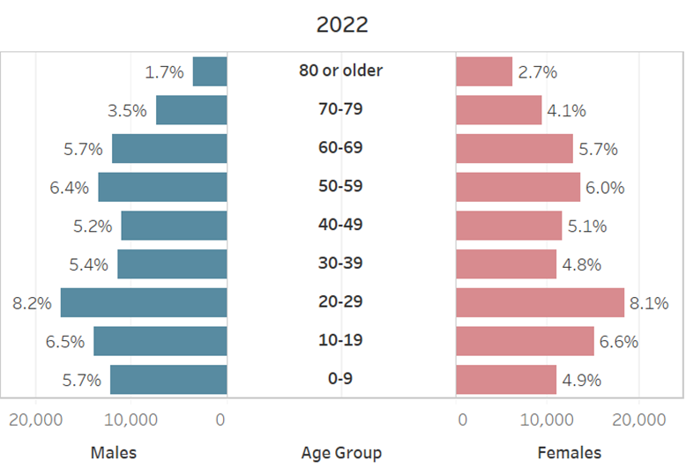
Population pyramid

Slide 5
Labor and Commutesheds
In-commuters are workers that commute to the county to work but live outside of the county. Same Work/Home indicator describes workers that live and work in the same county. Out-Commuters are workers that live within the county but commute to another county to work. The terms "journey to work" and "commuting" are interchangeable.
Economic development is sometimes affected by commuting in unanticipated ways. For example, strategies aimed at increasing jobs in a community will not necessarily mean jobs for residents. Conversely, creating job opportunities for residents does not always require bringing jobs into that community.
In-commuters minus out-commuters is the net-commuters. If a region has positive value for net-commuters, it is considered as an employment center.

Slide 6
Laborshed

Slide 7
Commuteshed

Slide 8
Educational attainment

Slide 9
Poverty
This indicator focuses on the total population and minors in poverty.
The Census Bureau uses a set of money income thresholds that are based on the size of family and ages of the family members. If a family's total income is less than the family's threshold, then that family and every individual in it is considered in poverty. The official poverty thresholds do not vary geographically, but they are updated for inflation using the Consumer Price Index (CPI-U). The official poverty definition uses money income before taxes and does not include capital gains or noncash benefits (such as public housing, Medicaid, and food stamps). The current measure was developed as an indicator of the number and proportion of people with inadequate family incomes for needed consumption of food and other goods and services.
The poverty measure has been widely used for policy formation, program administration, analytical research, and general public understanding.
High poverty includes any county or region with 20% or more of its population living below the poverty line for any given year of interest.
As such, the number of high poverty counties or regions can grow and decline dramatically over the course of a few short years, depending upon the socioeconomic characteristics of these counties and the health of their state and national economies.
Child poverty serves as an early signal of the long-term well-being of the nation since it can impact such key outcomes as family stability, educational attainment and workforce success.
Following the Office of Management and Budget's (OMB's) Directive 14, the Census Bureau uses a set of money income thresholds that vary by family size and composition to determine who is in poverty. If the total income for a family or unrelated individual falls below the relevant poverty threshold, then the family (and every individual in it) or unrelated individual is considered in poverty.

Slide 10
Poverty

Slide 11
Regional economic data

Slide 12
Economic Resilience

Slide 13
Industry clusters
Industry clusters are local and regional concentrations of competitive firms.
Bubble charts" are a useful tool for analyzing cluster strength in a region. A bubble chart provides three metrics for each cluster: Location quotient or LQ (which is the industry concentration in the region relative to the US) on vertical axis, growth rate (%) location quotient on vertical axis, and the number of employees (the relative size of the bubble).
The LQ for each cluster shows the relative concentration of employment in the cluster versus the concentration in the nation such that a higher concentration in one cluster means jobs are more concentrated than other clusters with lower LQs. Having a LQ below 1 indicates a lower concentration, however, LQ above 1 indicates a higher concentration or the capacity for exports outside the region.

Slide 14
Industry clusters
The firms and businesses within an industry cluster:
● Buy and sell from each other. ● Use similar technologies. ● Share a labor pool. ● Share supply chains. ● Share, leverage and promote innovation. ● Include supporting services and specialized infrastructure. ● Include both high and low-value added employment. ● Produce for exports outside the region. ● Drive the creation of wealth in a region.

Slide 15
Industry clusters

Slide 16
Industry clusters to watch
Chemicals – 1690 jobs
Agriculture, Food Processing and Technology - 4979 jobs
Biomedical and Biotechnical – 10,840 jobs
Defense and Security – 2298 jobs
Education and Knowledge creation – 4440 jobs (a 10.5% reduction in past 5 years)
Arts, Recreation, Entertainment and Visitor Industries – 1898 jobs

Slide 17
Advanced manufacturing clusters

Slide 18
Manufacturing clusters to watch
Transportation Equipment and Manufacturing – 3633 jobs
All other manufacturing clusters have shrunk in last 5 years

Slide 19
Occupation clusters
Occupation clusters show concentration of knowledge-based occupations focusing on higher educational attainment and skills in the regional economy. The selected occupation clusters below are comprised of occupations requiring at least a bachelor’s education or above. Higher skilled workforce is important for regions to participate in technology and knowledge-based innovation and economic development.
Growth rate in LQ is presented on the horizontal axis. LQ is a relative measure, such that a higher concentration in one cluster means that jobs are more concentrated compared to the national average. Having a LQ below 1 indicates a lower concentration, where a LQ of 1 or higher means more concentration of skilled workers in the occupation cluster.

Slide 20
Occupation clusters
Groups of occupations that share similar levels of (1) Knowledge, (2) Skills, or (3) Abilities.
Occupations clusters have similar characteristics: (1) Formal education (degrees, certifications, etc.); (2) Experience requirements; (3) Expertise: (4) Wage levels.
Why Study Occupation Clusters
1. Regional economic development strategies should be based on occupation and industrial development efforts.
2. Unique insights on knowledge, skills and abilities available in the rural regions.
3. Insights into occupation cluster is essential in the era of knowledge-based economy.
Benefits of Using Occupation Clusters
● Determine occupational strengths for your region. ● Find out what knowledge and skills are present in the workforce. ● Match/mismatch between region’s industry cluster and occupation cluster strengths. ● Determine how well positioned the region and its communities to participate effectively in the knowledge-based innovation economy.

Slide 21
Occupation clusters

Slide 22
Occupation clusters to watch
Educational occupations shrunk 6.3%
Medical occupations have shrunk 6.8%
Math occupations have grown 2.7%
IT occupations have shrunk 2.1%

Slide 23
Supply chain gaps
This statistic uses occupational forecasts and educational requirements and compares to the population forecasts for the region and educational attainment for resident population. If occupational demand exceeds the supply of skilled labor force from resident population, a supply deficit in occupation is expected. Occupations with minus jobs numbers show annual supply deficits expected in the next three years.
For example, if registered nurses show minus fifteen (-15), it means 15 nurse vacancies cannot be met by resident population. Hence, employer will have to attract nursing workers from out of the region. In contrast, if an occupation such as cashiers show plus seventy-eight (+78), it means there will be an annual surplus of 78 workers in cashiers’ occupation. In such cases, resident labor force will have to seek job opportunities out of the region.
Occupational deficits can cause wages to rise as employers compete for a limited number of workers. Occupational surplus can cause wages to fall as there are more workers competing for the same job opening. Partnerships with educational institutions are required to close the occupational deficit gap and ensure the annual supply of talent with specific skills. Economic developers can use the occupational surplus to pitch to a prospective industry or an employer.

Slide 24
Supply chain gaps
This statistic uses economic input output table for the region to show the opportunity employment available if supply chain leakages are closed for the specific industry sector. The chart focuses on manufacturing industry sectors.
Note that economic input output tables are estimates of selling and purchasing patterns within the regional economies. Hence, leakages and opportunity employment are estimates based on models and should not be considered as factual numbers. The information can be used to develop the manufacturing supply chain strategy for the region.

Slide 25
Supply Chain Gaps

Slide 26
Data and information
https://pcrd.maps.arcgis.com/apps/Cascade/index.html?appid=03d490639b2041c89302c1fcfcdc2d8a

